Slide 1
ROUTER

Slide 2
Introduction
In this lecture we are going to learn a little bit about routing in React. Up until now we have only written one-page applications. Once your application has multiple pages, you need to set up a reliable routing system. This is to handle the component or page that should be rendered when navigating to a certain route. For this we are going to use a package called react-router-dom.

Slide 3
Learning Outcomes
Explain how react-router-dom works

Slide 4
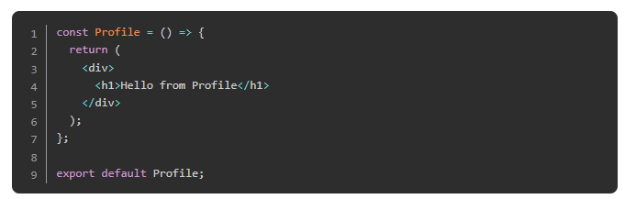
React Router
Let’s go through it step by step. First of all, create a new project using create-react-app and get rid of the boilerplate code as you already learned in previous lessons. (Just leave the index.js and the App.js files)
Once you’ve done that, let’s create a new file called Profile.js inside the src directory, and add a basic functional component to it, which just contains an h1 element

Slide 5
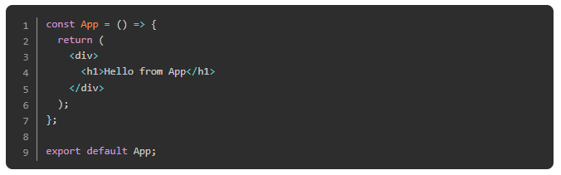
React Router
And also make sure your App.js file looks like this:

Slide 6
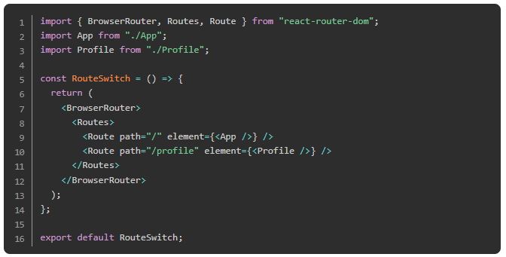
React Router
Once you have this, install the package. Open a terminal and run npm i react-router-dom. This is going to install all the dependencies for us. While this is happening, we can create a new file called RouteSwitch.js, which is going to be the file that handles our routes.
Once the package is finished installing, you can add this code to your RouteSwitch.js file:

Slide 7
React Router
So what is happening here? First we are importing React, our two components (Profile and App), and a few things from the package we just installed:
Route: Those are our routes with a path, which equals the url path, and a component that should be rendered when we navigate to this url.
BrowserRouter: Is a router, which uses the history API (pushState, replaceState and the popstate event) to keep your UI in sync with the URL. For completion we have to mention that there are other options than BrowserRouter, but for your current projects you can assume that BrowserRouter is at the root of all your projects.
Routes: Renders the first child Route that matches the location. In other words, the Routes component is going to look through all your Routes and checks their path. The first Route, whose path matches the url exactly will be rendered; all others will be ignored. Important to note is that in previous versions of react-router-dom the exact keyword was needed to achieve this behavior.

Slide 8
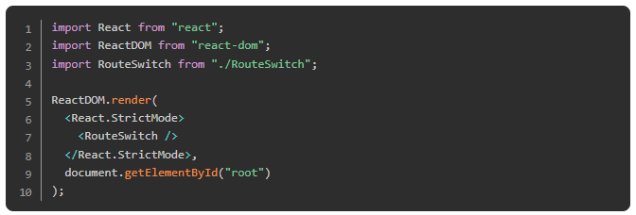
React Router
Let’s check this behavior in the browser for better understanding. But before we do that we have to do one more thing: change our index.js file. This is because we don’t want our App.js file to be the first file to be called when our application runs. Instead, we want our RouteSwitch.js to be the first. Your index.js should look something like this:

Slide 9
React Router
Once this is done, go ahead and run npm start and check out both routes: the home route “/” and the profile route “/profile”. Do this by changing the url in the browser accordingly.
You should now have enough basics to get started with React routing. There are a lot more features to react-router-dom which are extremely useful, but out of the scope of this lesson. If you are interested in learning some more, we recommend you look into the history or match object. Definitely go and check out more advanced concepts once you are familiar with the basics.

Slide 10
Practice
Go and add a few new routes to the application we created above; playing around with it is the best practice. Consider deleting it completely and rewriting it for practice.

Slide 11
Browse
Browse a little bit through the React Router documentation. You don’t need to read through all of it, nor understand all of it. Just browse through the concepts we discussed here and re-read them. This is a great resource to refer back to.

Slide 12
Watch
Watch this video for reviewing. You should already be familiar with those concepts.

Slide 13
Knowledge Check

Slide 14
How do you add page routing to a React project?
Notes:
🍐 This is a Pear Deck Text Slide
🍐 To edit the type of question, go back to the "Ask Students a Question" in the Pear Deck sidebar.

Slide 15
What are the three core components of React Router?
Notes:
🍐 This is a Pear Deck Text Slide
🍐 To edit the type of question, go back to the "Ask Students a Question" in the Pear Deck sidebar.

Slide 16
How do you ensure that Router links are routed accurately?
Notes:
🍐 This is a Pear Deck Text Slide
🍐 To edit the type of question, go back to the "Ask Students a Question" in the Pear Deck sidebar.

Slide 17
Resources
This video by The Net Ninja is an excellent review of what we learned here.
For some extra practice/review, check out this article.

Slide 18
Challenge Time!

Slide 19
Challenge: Shopping Cart
Now we are getting to our final React application. It’s going to be a shopping cart. This application should also have at least two routes to give you a chance to make some use of your newly acquired react-router-dom skills.

